Slide 1

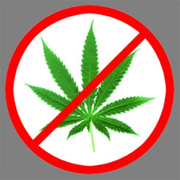
Marijuana IP
-Topic Introduction and PTO Response to Marijuana Trademarks
-Diversity vs. Federal Question Jurisdiction Issues
  -Fife Opt-Out Lawsuit
  -Trademark Adoption Mistakes Game
-Status of Marijuana Trademark Lawsuits
-Proposed RPC Comment
-Are Firms Pursuing or Avoiding Marijuana Work
The Seattle Intellectual Property American Inn of Court
Group 1 Presentation - September 18, 2014

Slide 2
Marijuana Trademarks and the PTO
Michael Atkins
Atkins Intellectual Property, PLLC

Slide 3
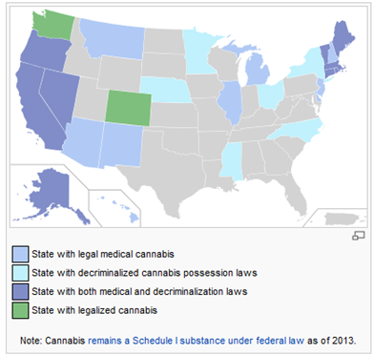
Current legal landscape

Slide 4
Marijuana defined for TM purposes
Includes:
  Marijuana/cannabis
  Goods containing marijuana/cannabis,
  e.g., baked goods, drinks, butter, and other “infused” edibles
    Oils, resins, balms
    Plants, seeds
Does not include hemp (unless hemp contains THC)
  Textiles and edibles registrable

Slide 5
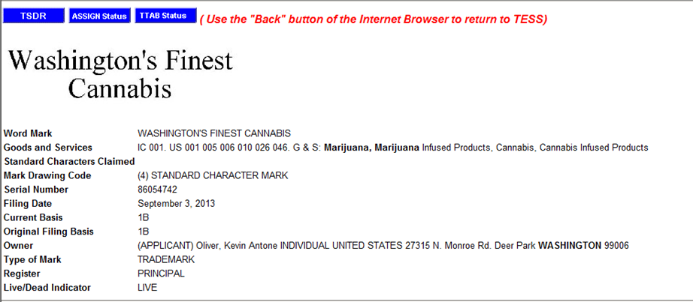
Application to register trademark for marijuana

Slide 6
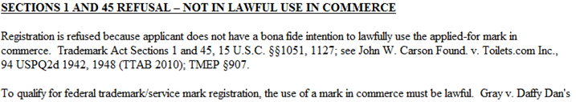
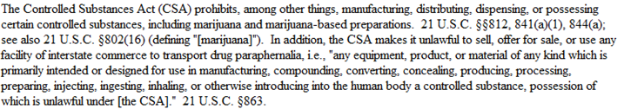
The PTO’s Response
***

Slide 7
Lawful use requirement
Section 1 of the Lanham Act
  “The owner of a trademark used in commerce may request registration of its trademark…”
Section 45
  “The word ‘commerce’ means all commerce which may lawfully be regulated by Congress.”
    Doesn’t matter if marijuana is lawfully regulated by the states

Slide 8
ID Manual entry?
Class 005: “Processed plant matter for medicinal purposes, namely medical marijuana”
PTO added entry for two months in 2010
Then deleted it as a “mistake”

Slide 9
MARIJUANA as a trademark for purely lawful goods?
MARIJUANA for teas and energy drinks
4 office action objections over 3 years
  Merely descriptive (Section 2(e)(1)) if beverage contains marijuana (in addition to being unlawful)
  Deceptive (Section 2(a)) if beverage does not contain marijuana
  Deceptively misdescriptive (Section 2(e)(1))
  Immoral or scandalous (Section 2(a))
Application abandoned

Slide 10
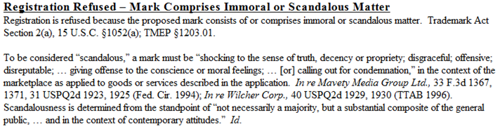

MARIJUANA shocks the sense of truth, decency, and propriety*
*According to the PTO
***

Slide 11
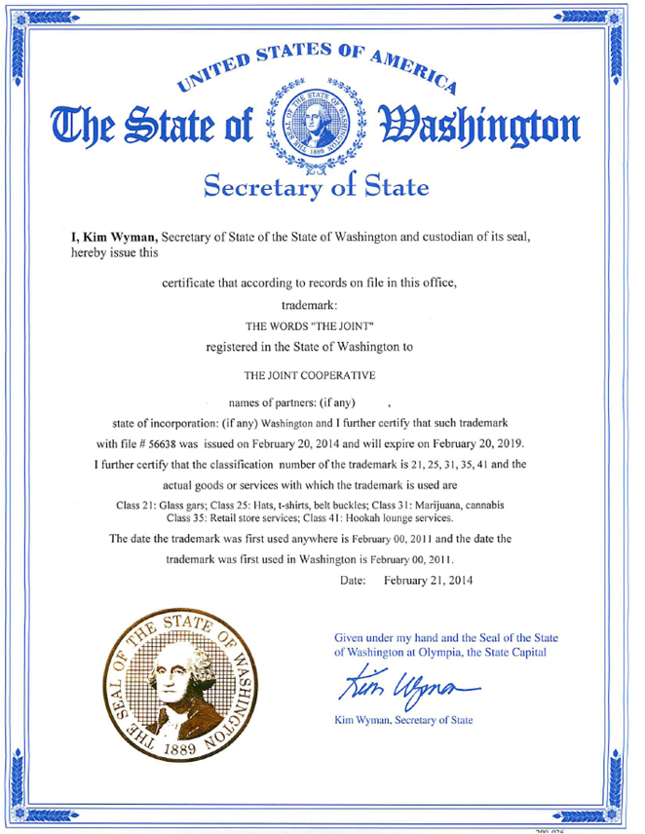
Of course, marijuana is now legal in Washington…
“Marijuana Trademark”
Trademark Owner

Slide 12
Of course, marijuana is now legal in Washington…
“Marijuana Trademark”
Trademark Owner

Slide 13
Of course, marijuana is now legal in Washington…
“Marijuana Trademark”
Trademark Owner

Slide 14
New issue for the
Trademark Trial and Appeal Board
Standing granted to any person who would be “damaged” by registration
  Includes unregistered uses
  Includes purely local uses
So can marijuana provider (legal in WA, but illegal under federal law) succeed in a TTAB proceeding based on its prior rights in WA and a likelihood of confusion?

Slide 15
Where do you bring your lawsuit?
Carol Pitzel Cruz
Knobbe Martens Olson & Bear LLP

Slide 16
Jurisdiction
Federal Jurisdiction
  Federal Question
    District courts have jurisdiction over actions “arising under the Constitution, laws, or treaties of the United States.” 28 U.S.C. §1331.
  Diversity
    Amount in controversy exceeds $75,000. 28 U.S.C. §1332
    Diversity of citizenship. Id.
State Court?
  Courts of General Jurisdiction
  Cause of action under Washington State Trademark Law? Common Law rights? Contract Issue? Lanham Act?

Slide 17
Is your Dank in the Tank?
Is your Hash being Bashed?
Reviewing the consequences of
MMH, LLC v. City of Fife
Law Firm of Wesner & Beattie, B.S.

Slide 18


Slide 19
Fife – at the foot of Mount Rainier
You probably bought a car there
But not any weed; Don’t expect to get any there on the way to Portland

Slide 20
Case Background
MMH, LLC obtained a valid marijuana retail license by complying with the requirements of I-502
MMH sought to open a retail facility in the City of Fife
In response to I-502, the City sought to propose an Ordinance regulating marijuana operations
Everything was copacetic . . . dude . . . until:

Slide 21
Case Background
Not so fast
That Ordinance was headed to passage when one Councilman proposed a last-minute amendment – which contained an outright ban on the production, processing, and retail sale of marijuana within Fife City limits
The Ordinance (No. 1872) passed
As a result, Fife did not and will not issue a business license to MMH – bummer dude

Slide 22
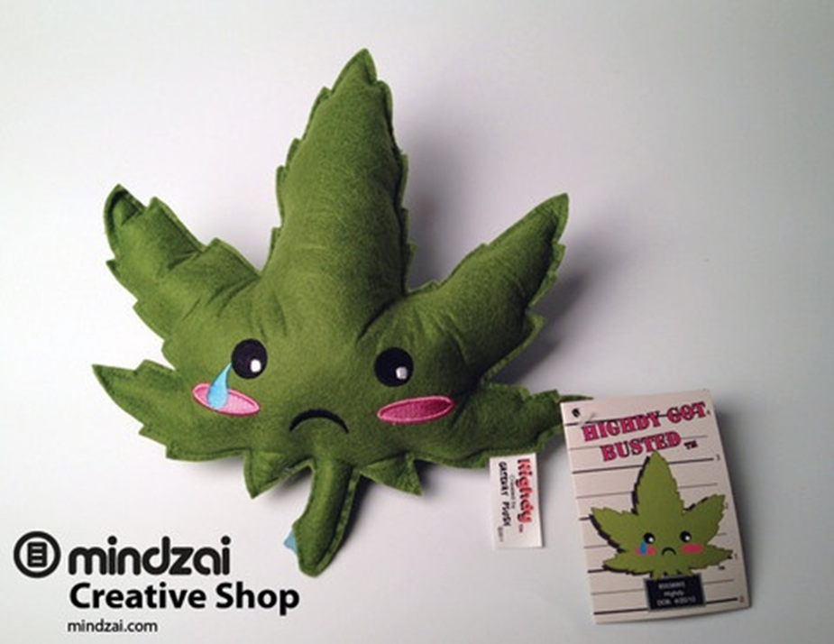

Slide 23
Case Background
On July 15, 2014 MMH filed suit in Pierce County Superior Court seeking to overturn Fife’s ban, asserting claims of Statutory and Constitutional Preemption
The City of Fife answered on August 4, and raised as an affirmative defense the inability of the Court to grant the relief sought without violating “the Supremacy Clause of the United States Constitution and Federal Laws….”
Essentially, the City defended itself by saying that the Court could not grant the requested relief because marijuana remains illegal under federal law

Slide 24
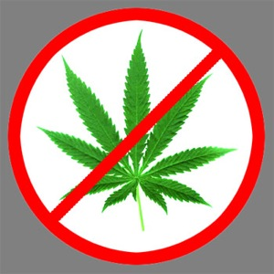

Slide 25
!
All hell broke loose:
Fife’s defense attacked the legality of I-502 itself
The burgeoning Washington pot industry panicked
Various amici weighed in (in friendly and unfriendly ways)
National attention was visited upon the town of Fife, NOT FORKS, and then of course . . .

Slide 26
The ACLU got involved:
On August 26, Downtown Cannabis Company and others, represented by the ACLU, filed a Complaint in Intervention restating MMH’s claims for Statutory and Constitutional Preemption, and
Raising an additional claim seeking a declaration of non-preemption under federal law
The Complaint in Intervention included an exposition why I-502 is not in conflict with the federal Controlled Substances Act

Slide 27
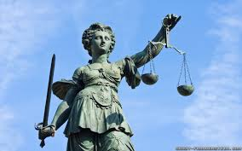
The decision …
On August 29 Pierce County Superior Court Judge Ronald Culpepper ruled from the bench that the City of Fife can ban state-legalized marijuana businesses
Judge Culpepper described his ruling as “narrow” and only related to the ability of municipalities to enact local zoning

Slide 28
The decision …
The City’s ability to regulate marijuana businesses derives from art. XI, section 11 of the WA Const., which provides that “[a]ny county, city, town, or township may make and enforce . . . all such local police, sanitary, and other regulations not in conflict with general laws.”
Initiative 502 did nothing to restrict or preempt this local authority.

Slide 29
The decision …
Ergo, Fife has the right to pass an ordinance restricting retail sales of marijuana.
However, since the superior court decided the case on this narrow ground, it did not have to reach the issue of whether federal law preempts Initiative 502 under the Supremacy Clause.

Slide 30

Dude, Does That Mean We Now Have A Police State, Man?

Slide 31
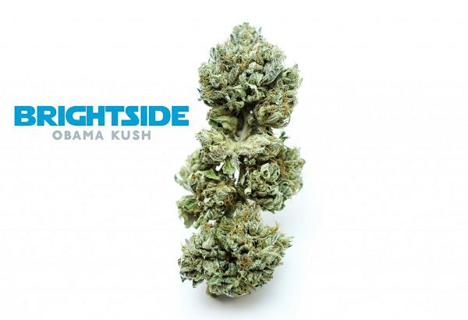
Nope…
Pot is banned in Fife
But there a bright side to Judge Culpepper’s ruling for all you “midnight tokers”

Slide 32
Pot Sales in WA Still Groovy
On the one hand, the ruling supports the right of municipalities to separately regulate marijuana operations within their territories
On the other hand, the ruling avoids the thorny issue of conflict with federal law
If a court decides that our locally grown pot initiative conflicts with the Controlled Substances Act, then it may be game over dude.

Slide 33
Pot Sales in WA Still Groovy
Rejoice therefore
Pot, hash, dope, dank, score, swag, roach, cannabis, weed, reefer, ganja, etc. is still available in many towns near you.
Legal Disclaimer: Paul Beattie’s Adding to and Presenting of Greg Wesner’s Slideshow on Cannabis in No Way Indicates That Mr. Beattie Ever Inhaled.

Slide 34
What’s Wrong with this Marijuana Trademark?
The Game!! TM
Michael Atkins
Atkins Intellectual Property, PLLC

Slide 35
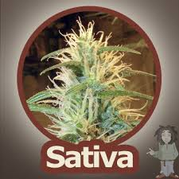
SATIVA-brand cannabis?
What’s wrong with this trademark?

Slide 36
SATIVA-brand cannabis?
It’s generic!
Learn the lingo:
  “Indica” is another type of cannabis plant
  “Kush” is slang for indica
  Lots – and I mean lots – of other slang words for generic goods

Slide 37

ROCKY MOUNTAIN HIGH for a marijuana dispensary?

Slide 38
ROCKY MOUNTAIN HIGH for a marijuana dispensary?
If it’s for a Seattle dispensary, it might be geographically deceptively misdescriptive
Section 2(e)(3)
If it’s for a Denver dispensary, it might be geographically descriptive
Section 2(e)(2)

Slide 39
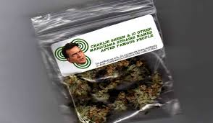
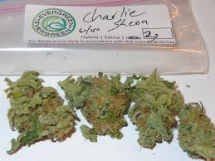
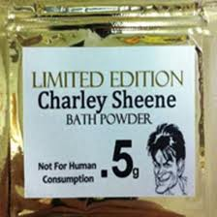
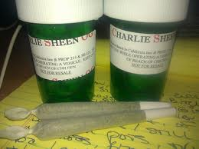

CHARLIE SHEEN cannabis?

Slide 40
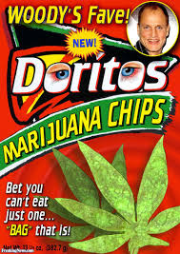
CHARLIE SHEEN cannabis?
False designation of origin
Violates personality rights laws
  RCW 63.60.010: “Every individual … has a property right in the use of his or her name, voice signature, photograph, or likeness.”

Slide 41
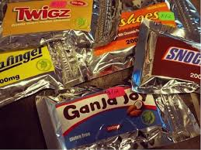
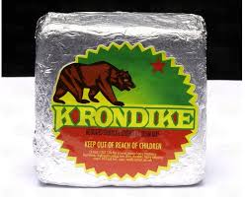
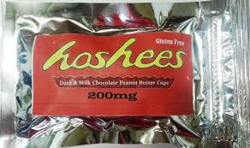
Parody candy names?

Slide 42
Parody candy names?
They’re not a parody at all!
  Parody requires simultaneous contradictory message + criticism about trademark owner. Otherwise, it’s “brandalism”
  So doesn’t constitute fair use
Trademark infringement/false designation of origin
Dilution of famous trademark

Slide 43
Recent Marijuana Trademark Litigation
Antoine McNamara, Carmen Wong
Perkins Coie LLP

Slide 44
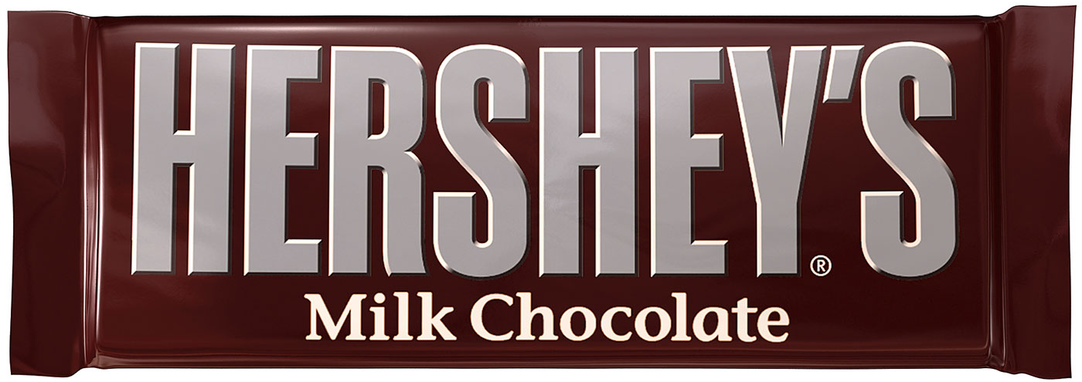
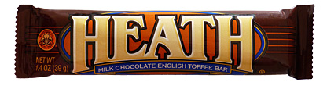
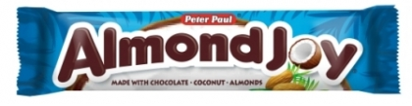
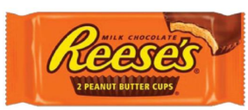
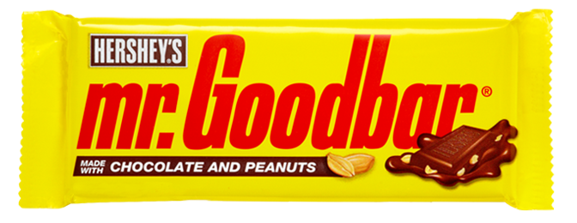
The Hershey Company cases

Slide 45
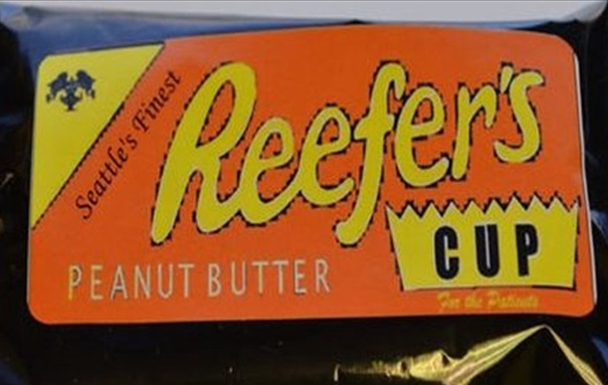
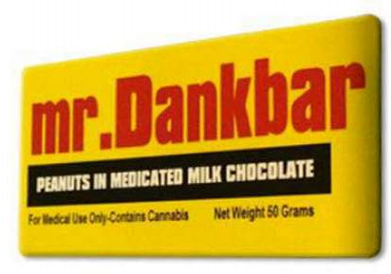
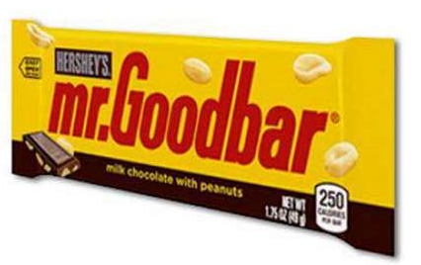
The Hershey Company et al. v.
Conscious Care Cooperative (W.D. Wash)

Slide 46
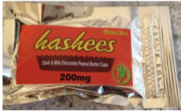
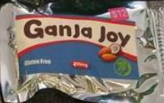
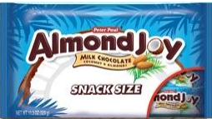
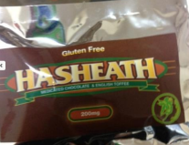

The Hershey Company et al. v.
TinctureBelle, LLC (D. Colo.)

Slide 47
Hershey cases – Procedural History
Conscious Care Cooperative (W.D. Wash.)
  Filed June 3, 2014 – assigned Judge Lasnik
  Settled Aug. 20, 2014
  No discovery / motions
  Def. will stop selling & destroy existing accused products
TinctureBelle (D. Colo.)
  Filed June 3, 2014 – assigned Judge Wiley Daniel
  Parties are negotiating a settlement
  No discovery / motions

Slide 48
Hershey cases – Legal Issues
Mostly standard trademark issues
  Registered trademarks themselves are unrelated to marijuana
However, the cases present some unique issues related to the nature of the accused products:
  Hershey alleges that the accused products “dilute and tarnish Hershey’s marks by creating an association in consumer’s minds with products containing cannabis”
  Hershey alleges that the accused products “create a genuine safety risk [to] children, who may not distinguish between Hershey’s candy products and [the cannabis products] and may inadvertently ingest defendant’s products thinking they are ordinary chocolate candy.”

Slide 49
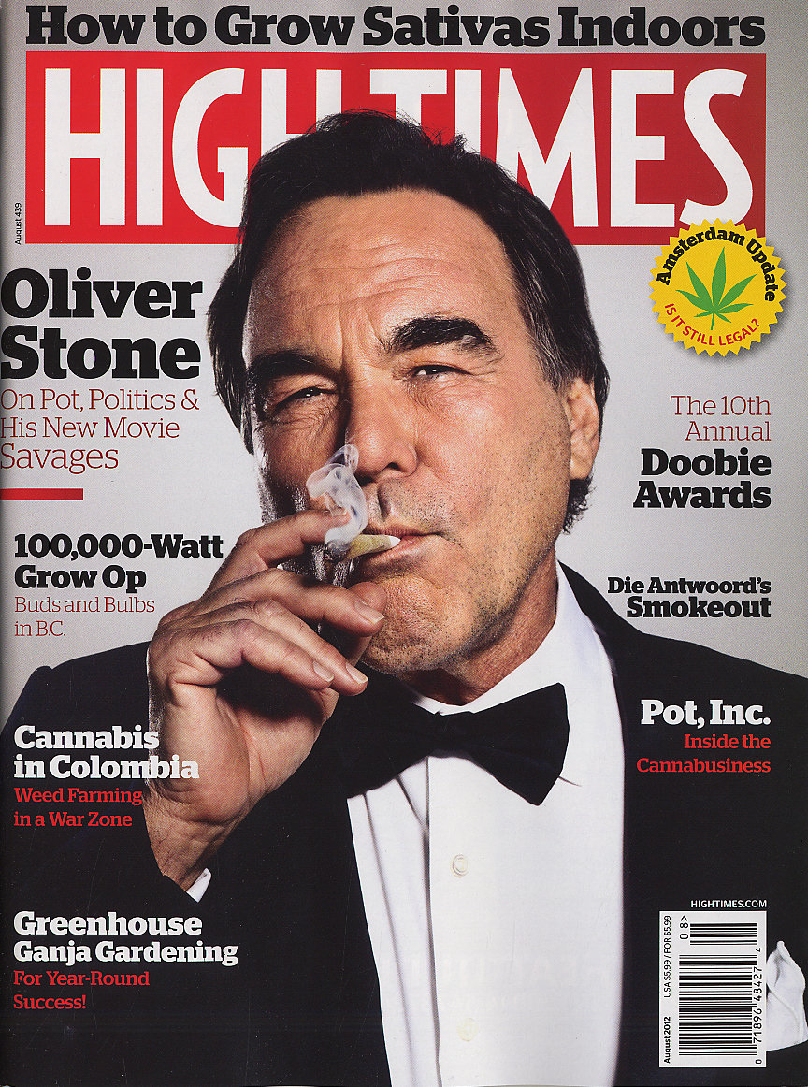
Trans-High Corporation cases
Registered Trademarks:
  “High Times”
  “Cannabis Cup”
  “420.com”
  “Bonghitters”
  “Potcast”
  “Pix of the Crop”
  …

Slide 50
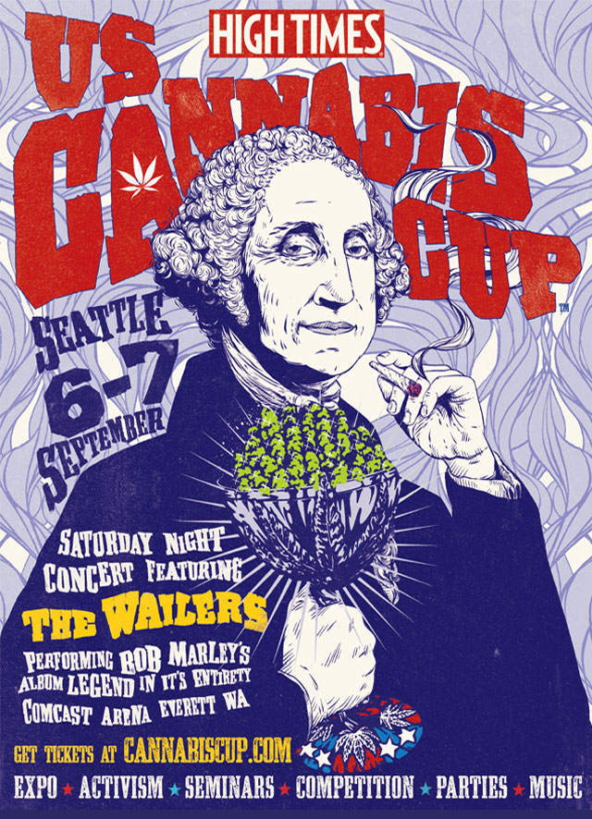
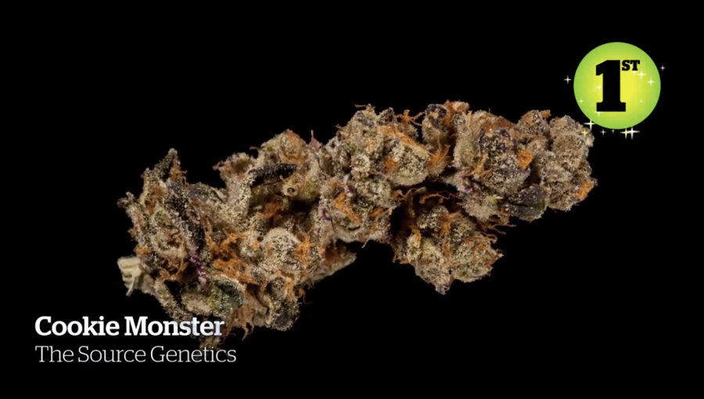
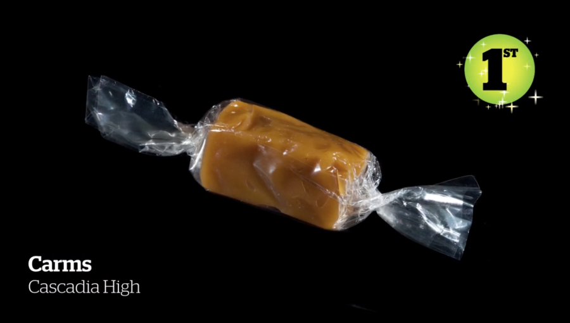
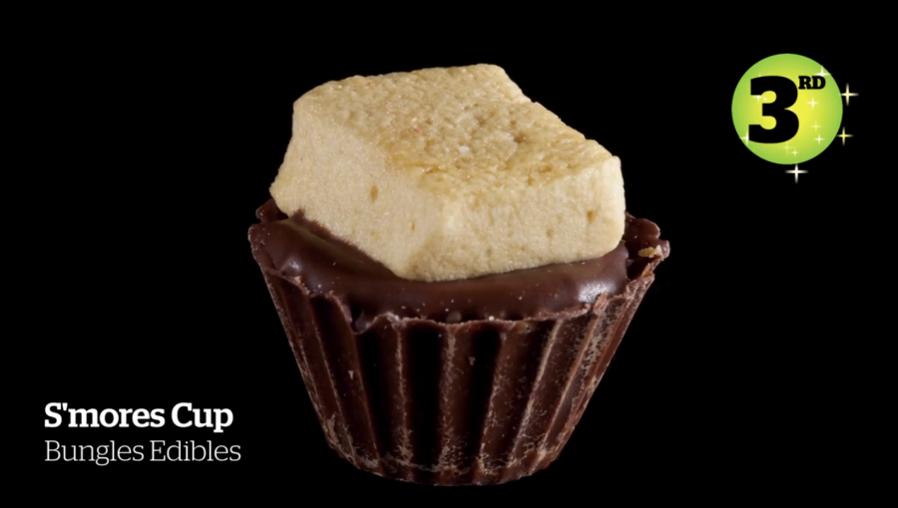
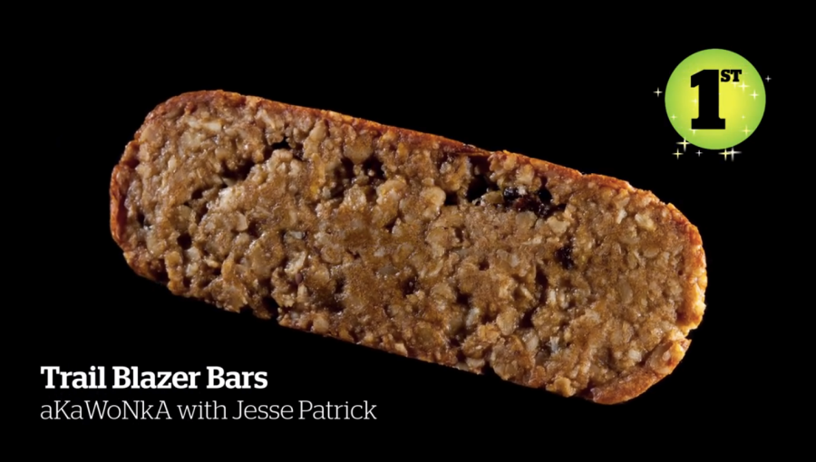
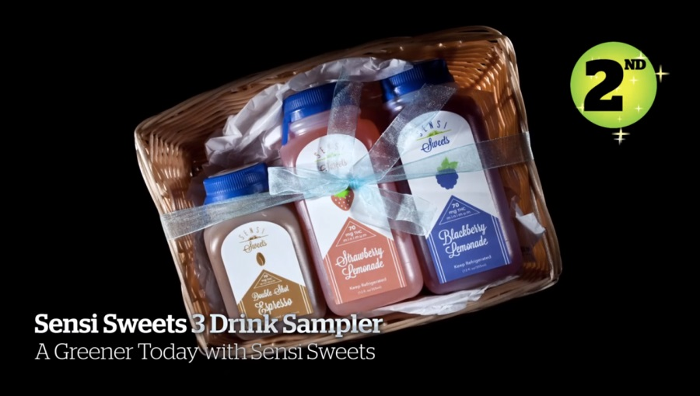
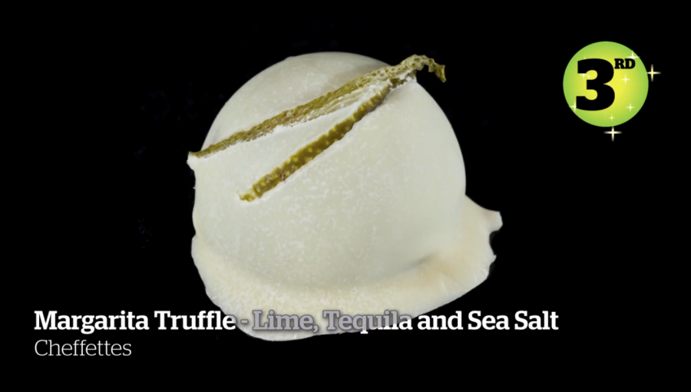
Trans-High v. NW Harvest Fest (W.D. Wash)
2-Day Conference:
  The Art of Edibles (Sat. 2pm)
  Canna-business 101: How to open yours! (Sun. 1pm)
Competition:
  Judge’s Pass - $250

Slide 51
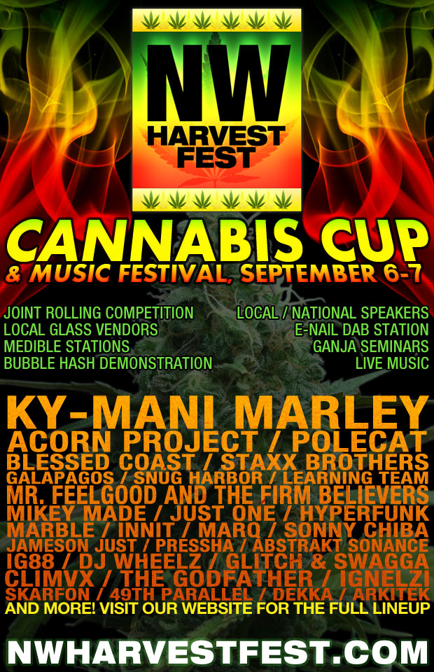
Trans-High v. NW Harvest Fest (W.D. Wash)
Northwest Harvest Fest
  Promoted own “Cannabis Cup”
Trans-High sues Aug. 2013
  Trademark Counterfeiting
  Trademark Infringement
  Unfair competition
Answer filed Sept. 25, 2013
  No challenge to trademarks
Parties settle Jan. 10, 2014
  Stipulated to trademarks’ validity
  Stipulated to permanent injunction

Slide 52
Trans-High v. NW Harvest Fest – Legal Issues
Trans-High’s “Cannabis Cup” marijuana competition is
illegal under federal law (and possibly state law).
Identification of Goods & Services raises questions:
Registered Trademark | Identification of Goods & Services
“Cannabis Cup” | “Organization and arrangement of exhibitions, harvest festivals featuring a variety of activities, namely art and craft exhibitions, organization and arrangement of educational and instructional seminars and conferences in the field of cannabis.”
“US Cannabis Cup” | “Organization and arrangement of educational and instructional seminars and conferences regarding legal, medical and political developments and societal attitudes about marijuana not including the provision or display of marijuana, marijuana-based preparations, or marijuana extracts or derivatives, synthetic marijuana, or other substances controlled by the controlled substances act.”

Slide 53
Trans-High Corporation – “High Times” cases
Trans High v. Mile High Times LLC – (S.D.N.Y.)
  Defendant published magazine “Mile High Times”
  Suit filed March 24, 2014; settled April 29, 2014
  Defendant agrees to injunction as to “Mile High Times,” but parties agree that use of “Mile High” by itself would not be prohibited
Trans High v. Reimers – (E.D. Wash.)
  Defendant opened retail store in Ephrata, WA – “High Time Station”
  Suit filed August 25, 2014; answer filed September 16, 2014
  Counterclaim – Cancellation of Federal Registration of Trademark
    Plaintiff’s “magazine and website offer for sale, among other things, paraphernalia utilized in the consumption and use of marijuana, products used in the production of marijuana, marijuana seeds, and psilocybin mushroom spores to produce psilocybin, the latter of which is like marijuana, a controlled substance under Federal law.”
    “Since Plaintiff is not making a lawful use of the mark in commerce, the mark is not entitled to Federal registration and the existing registration should be cancelled.”

Slide 54
Marijuana IP and Ethics
Davina Inslee
IP Counsel, Vulcan Inc.

Slide 55
RPC Rule 1.2 Scope of Representation and Allocation of Authority Between Client and Lawyer
(a) Subject to paragraphs (c) and (d), a lawyer shall abide by a client's decisions concerning the
objectives of representation and, as required by Rule 1.4, shall consult with the client as to the means by
which they are to be pursued. A lawyer may take such action on behalf of the client as is impliedly authorized
to carry out the representation. A lawyer shall abide by a client's decision whether to settle a matter. In
a criminal case, the lawyer shall abide by the client's decision, after consultation with the lawyer, as to
a plea to be entered, whether to waive jury trial and whether the client will testify.
(b) A lawyer's representation of a client, including representation by appointment, does not constitute
an endorsement of the client's political, economic, social or moral views or activities.
(c) A lawyer may limit the scope of the representation if the limitation is reasonable under the
circumstances and the client gives informed consent.
(d) A lawyer shall not counsel a client to engage, or assist a client, in conduct that the lawyer knows
is criminal or fraudulent, but a lawyer may discuss the legal consequences of any proposed course of conduct
with a client and may counsel or assist a client to make a good faith effort to determine the validity, scope,
meaning or application of the law.
(e) [Reserved.]
(f) A lawyer shall not purport to act as a lawyer for any person or organization if the lawyer knows
or reasonably should know that the lawyer is acting without the authority of that person or organization,
unless the lawyer is authorized or required to so act by law or a court order.

Slide 56
The following Proposed Change to the Rule Comment section for RPC 1.2 was published for comment in June 2014 for a period that expired on September 6, 2014.
Special Circumstances Presented by Washington Initiative 502
[18] At least until there is a change in federal enforcement policy, a lawyer may counsel a client
regarding the validity, scope, and meaning of Washington Initiative 502 and may assist a client in conduct
that the lawyer reasonably believes is permitted by this initiative and the statutes, regulations, orders
and other state and local provisions implementing them.
Role of Comments: “The Comment accompanying each Rule explains and illustrates the meaning and purpose of the Rule…The Comments are intended as guides to interpretation, but the text of each Rule is authoritative.”

Slide 57
8 comments were received during the comment period
Issues:
Advising clients with regard to state and federal laws – “ a lawyer may counsel”
Aiding and abetting a federal felony – “may assist a client”
http://www.courts.wa.gov/court_rules/?fa=court_rules.commentDisplay&ruleId=373

Slide 58
Colorado Rules of Professional Conduct
Rule 1.2.
Scope of Representation and Allocation of Authority Between Client and Lawyer
Comment
[l4]A lawyer may counsel a client regarding the validity, scope, and meaning of Colorado constitution article XVIll. secs. 14 & 16. and may assist a client in conduct that the lawyer reasonably believes is permitted by these constitutional provisions and the statutes, regulations, orders, and other state or local provisions implementing them. In these circumstances, the lawyer shall also advise the client regarding related federal law and policy.
Amended and Adopted by the Court, En Banc, March 24, 20L4, effective immediately.
Justice Coats and Justice Eid would not approve Comment [l4].

Slide 59
Are Law Firms Pursuing or Avoiding Marijuana …
WORK?
Dario Machleidt
Kilpatrick Townsend & Stockton LLP

Slide 60
The Work Is There, But Do You Want It?
Will you / your firm pursue marijuana IP work?
Will you / your firm avoid marijuana IP work?
What will your liability insurer say?
Hershey v. Conscious Care lawyers: any thoughts on the matter?

Slide 61
Questions?

