Slide 1
The Vanishing Civil Trial Team 6

Slide 2
A panel Discussion With
Hon. John C. Coughenour Hon. Robert S. Lasnik Hon. James L. Robart Jerry A. Riedinger, Esq. Prof. Margaret Chon

Slide 3
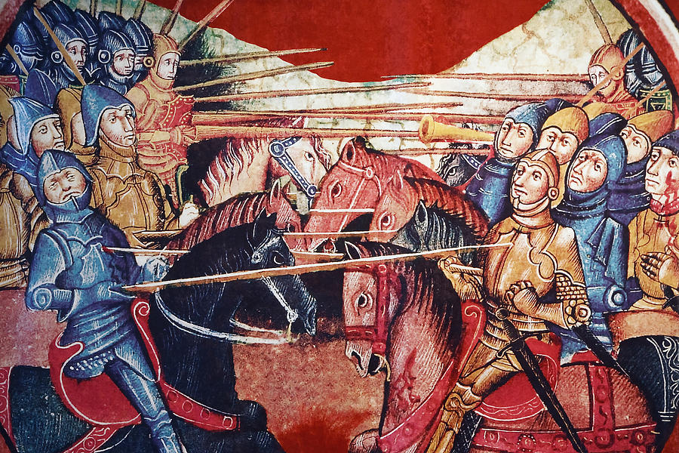
In the beginning…
Kings oppressed Noblemen and often ruled with iron-fisted cruelty and capriciousness.

Slide 4
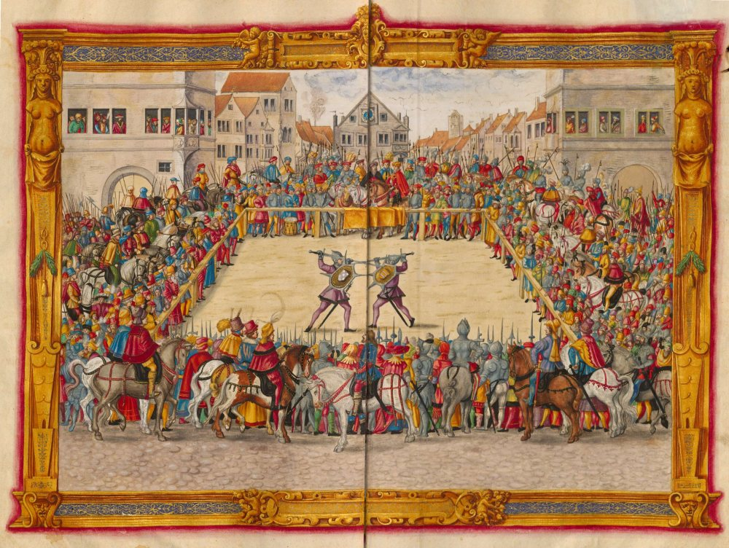
In the beginning…
“Civil” trials were not so civil…

Slide 5
In a land far, far away, Long, long ago, Enlightenment began to emerge Out of the Dark Ages…

Slide 6
Origin of early Jury Trials
Magna Carta (1205) appears to have the first Jury trial guarantee . . . but only for noblemen
Clause 39:
no free man shall be seized or imprisoned or stripped of his rights or possessions, or outlawed or exiled, or deprived of his standing in any way . . . Except by lawful judgment of his equals . . . .

Slide 7
Development of Jury Trials: Anglo-American Tradition
Early Jury Trials (1100 – 1400)
Concentrated hearing
Jury of illiterate locals
Jury investigated facts and rendered ruling at “trial”

Slide 8
Development of Jury Trials: Anglo-American Tradition
Pre Code-Pleading Era (1400 – 1850)
Characteristics Retained:
Concentrated hearing
Jury of illiterate locals
Changes:
Jury no longer investigated facts
Jury listened to lawyers and witnesses
Trials held in open spaces (town squares); modern courtroom had not yet developed yet

Slide 9
Development of Jury Trials: Anglo-American Tradition
Pre Code-Pleading Era (continued)
Additional Changes:
Pleadings
No pretrial discovery at common law
Equity courts developed, in part, to allow discovery
Fun Fact:
Parties were disqualified as witnesses for bias until mid-1800s

Slide 10
Jury Trial Enshrined in Bill of Rights
Founders were enamored with Jury Trial
“The history of the present King of Great Britain is a history of repeated injuries . . . [including] depriving us in many cases, of the benefits of Trial by Jury.”
Declaration of Independence
“I consider [trial by jury] as the only anchor ever yet imagined by man, by which a government can be held to the principles of its constitution.”
Thomas Jefferson

Slide 11
Jury Trial Enshrined in Bill of Rights
Founders were enamored with Jury Trial
“The civil jury is a valuable safeguard to liberty.”
James Madison
“In suits at common law, trial by jury in civil cases is as essential to secure the liberty of the people as any one of the pre-existent rights of nature.”
James Madison

Slide 12
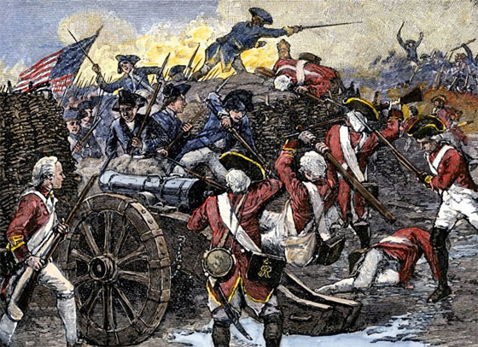
Development of Jury Trials: Anglo-American Tradition

Slide 13
Seventh Amendment to U.S. Constitution
Civil Trials
In Suits at common law, where the value in controversy shall exceed twenty dollars, the right of trial by jury shall be preserved . . . .

Slide 14
Development of Jury Trials: Anglo-American Tradition
Code-Pleading Era (1850 – 1938)
Lack of discovery at Common Law led to Code-Pleading-Era
Code Pleading attempted to merge law and equity, but failed to remedy problems with earlier trials
Bringing suit still depended on ability to sufficiently plead causes of action prior to discovery

Slide 15
Development of Jury Trials: Anglo-American Tradition
Federal Rules of Civil Procedure (1938)
FRCPs ushered in era of pre-trial discovery with minimal pleading phase
FRCPs did not intend to affect jury right
FRCP 38(a):
“The right of trial by jury as declared by the Seventh Amendment . . . is preserved to the parties inviolate.”

Slide 16
Development of Jury Trials: Federal Rules of Civil Procedure
FRCPs, however, have impacted incidence of trials
*John H. Langbein, The Disappearance of Civil Trial in the United States, 122 Yale L. J. 522, 524 (2012).

Slide 17
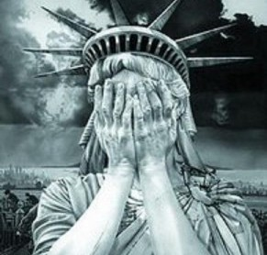

Slide 18
Development of Jury Trials: Federal Rules of Civil Procedure
Primary Author Wanted FRCPs to Encourage Settlement
“[O]ne of the greatest uses of judicial procedure is to bring parties to a point where they will seriously discuss settlement.”
Edson Sunderland

Slide 19
Development of Jury Trials: Federal Rules of Civil Procedure
Primary Author Wanted FRCPs to Encourage Settlement
“Many a case would be settled, to the advantage of the parties and to the relief of the court, if the true situation could be disclosed before the trial begins.”
Edson Sunderland

Slide 21
Interlude – Different Trial Traditions
Anglo-American
Jury-based
Pretrial/Trial Division
Meant to prevent surprise
Concentrated and Continuous
Jury management
Continental System
Often no Jury
No Pretrial/Trial Division
If surprise evidence, additional hearings ordered
Discontinuous
Professional Judges decide cases

Slide 22
Interlude – Different Trial Traditions
Anglo-American
Oral Testimony
Originally illiterate juries
U.K. has largely abandoned
Public
Deter false testimony
Partisan Presentation
Cross-examination key
Continental System
Documentary Evidence Largely
Private
Judge investigate facts

Slide 23
Interlude – Justifications for Trials
Ultimate Dispute Resolution Mechanism
Resolution of Close Cases of Disputed Facts
Necessary to give potency to ADR and Settlement
Citizen Involvement in Government
Besides voting, most likely way average citizen will “directly” participate in Gov’t
Check on Gov’t Power
Development of Law

Slide 24
Federal Rules: Not The Whole Story
Although jury trials declined after adoption of the FRCPs, the situation is more complex

Slide 25
Trials – 1962 to 2013

Slide 26
Jury Trials – 1962 to 2013

Slide 27
Trial Rate – 1962 to 2013

Slide 28
Jury Trial Rate – 1962 to 2013

Slide 29
Trials Per Judgeship – 1962 to 2013

Slide 30
Jury Trials Per Judgeship – 1962 to 2013

Slide 31
Trials per Capita (Mil.) – 1962 to 2013

Slide 32
Jury Trials per Capita (Mil.) – 1962 to 2013

Slide 33
Quick Observation
From 1962 to mid-1980s:
Increase in trial rate when compared to population growth
BUT
Decrease in trial rate when compared to civil dispositions
Reason?
Total litigation increased at a vastly faster rate than population growth
1970s and 1980s consumer and civil rights lawsuits

Slide 34
Trials per Billion $ Real GDP (2005 US $)

Slide 35
Takeaways
FRCPs Did Have Major Effect in Trial Rate
Increased opportunity for settlement
Increased cost (expansive pretrial discovery)
Trial Rate in 1970-80s due to Consumer Protection and Civil Rights Lawsuits

Slide 36
Takeaways
Decrease in Trials and Trials Rates After Mid-1980s Likely Due to:
Increased case management
“Individual” case assignment (late 1960s)
Summary Judgment Liberalized
Celotex – Anderson – Matsushita (1986)
Legislation requiring each district court to implement ADR program
Alternative Dispute Resolution Act of 1998

Slide 37
IP Trial Statistics

Slide 38
Copyright Trials – 1962 to 2013

Slide 39
Copyright Jury Trials – 1962 to 2013

Slide 40
Trademark Trials – 1962 to 2013

Slide 41
Trademark Jury Trials – 1962 to 2013

Slide 42
Patent Trials – 1962 to 2013

Slide 43
Patent Jury Trials – 1962 to 2013

Slide 44
Total IP Trials – 1962 to 2013

Slide 45
Total IP Jury Trials – 1962 to 2013

Slide 46
Trial Rate – 1962 to 2013

Slide 47
IP Trials Per Judgeship – 1962 to 2013

Slide 48
Quick Observation
Most Federal Judges Are Likely Not Conducting At Least One IP Trial On Annual Basis:
Patent Cases Dominate
Select Few Courts Hear Majority of Patent Trials
E.D. Tex.
D. Del.
N.D. Cal.
E.D. Va.

Slide 49
IP Trials per Capita (Mil.) – 1962 to 2013

Slide 50
IP Trials per Billion $ Real GDP (2005 US $)

Slide 51
Western District of Washington Trial Statistics

Slide 52
Trials – W.D. Wash. – 1968 to 2013

Slide 53
Jury Trials – W.D. Wash. – 1968 to 2013

Slide 54
Trials Per Judgeship – W.D. Wash. – 1968 to 2013

Slide 55
Statistics on IP Trials in the Western District of Washington Not Readily Available

Slide 56
IP Case Filings – All US District Courts – Selected Years: 1977 - 2013

Slide 57
IP Case Filings – W.D. Wash. – Selected Years: 1977 - 2013

Slide 58
IP Case Filings – Comparison – Selected Years:1977 - 2013

Slide 59
Panel Discussion

